Slide 1
Notes:
Image: Chapter One: Modern Project Management Title Slide
This is a good time to be reading a book about project management. Project management skills are both valuable and critical to sustainable economic growth. New jobs and competitive advantage are achieved by constant innovation, developing new products and services, and improving both productivity and quality of work.
This text is written to provide the reader with a comprehensive, integrative understanding of the project management process. The text focuses both on the science of project management and the art of managing projects. Throughout this text you will be exposed to the major aspects of the project management system.

Slide 2
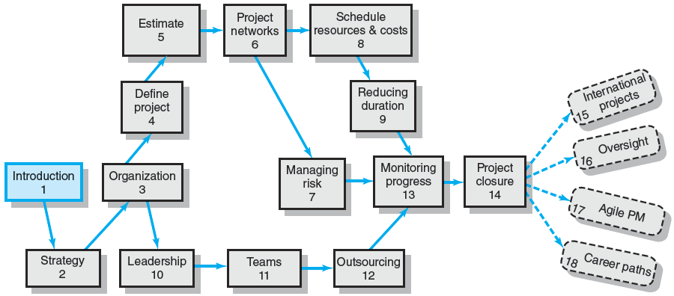
An Overview of Project Management 6e.
Notes:
Image: An Overview of Project Management 6e.
Following this introductory chapter, Chapter 2 focuses on how organizations go about evaluating and selecting projects and the importance of aligning project selection to the mission and strategy of the firm. Chapter 3 examines matrix management and organizational forms and the role an organization’s culture plays in the implementation of projects.
Chapter 4 deals with defining project scope and developing a work breakdown structure (WBS). Formulating cost and time estimates is the subject of Chapter 5. Chapter 6 focuses on utilizing WBS information to create a project plan in the form of a timed and sequenced network of activities.
Chapter 7 examines how to identify and manage risks associated with project work. Resource allocation is the focus of Chapter 8 with special attention devoted to how resource limitations impact the project schedule. Chapter 9 examines strategies for reducing (“crashing”) project time either prior to project start or in response to problems or new demands placed on the project.
Chapters 10 focuses on the role of the project manager as a leader and stresses the importance of managing project stakeholders within the organization. Chapter 11 reviews the leadership skills and techniques required for developing a high-performance core project team. Chapter 12 discusses how to outsource project work and negotiate with contractors, customers, and suppliers.
Chapter 13 focuses on the information managers use to monitor project progress, with special attention devoted to the key concept of earned value. Chapter 14 covers closing out a project and the assessment of performance and lessons learned. Implementation of project management in multicultural, international environments is the subject of Chapter 15. Chapter 16 focuses the need for and the impact of organizational oversight. Agile project management, is the subject of Chapter 17. Finally, Chapter 18 concludes with coverage of career issues in the field of project management.

Slide 3
What is a Project?
Project Defined
A complex, nonroutine, one-time effort limited by time, budget, resources, and performance specifications designed to meet customer needs.
Major Characteristics of a Project
Has an established objective.
Has a defined life span with a beginning and an end.
Requires across-the-organizational participation.
Involves doing something never been done before.
Has specific time, cost, and performance requirements.
Notes:
What is a Project?
A project is a temporary endeavor undertaken to create a unique product, service, or result to meet customer needs. The characteristics of a project help differentiate it from other endeavors of the organization.
Project Defined
A complex, nonroutine, one-time effort limited by time, budget, resources, and performance specifications designed to meet customer needs.
Major Characteristics of a Project
Has an established objective.
Has a defined life span with a beginning and an end.
Requires across-the-organizational participation.
Involves doing something never been done before.
Has specific time, cost, and performance requirements.

Slide 4
Program versus Project
Program Defined
A series of coordinated, related, multiple projects that continue over an extended time and are intended to achieve a goal.
A higher level group of projects targeted at a common goal.
Examples:
Project: completion of a required course in project management.
Program: completion of all courses required for a business major.
Notes:
Program versus Project
The terms project and program can cause confusion as they are often used synonymously, however a program has a longer time span and is of a larger scale as it is typically comprised of a group of related projects.
Program Defined
A series of coordinated, related, multiple projects that continue over an extended time and are intended to achieve a goal.
A higher level group of projects targeted at a common goal.
Examples:
Project: completion of a required course in project management.
Program: completion of all courses required for a business major.

Slide 5
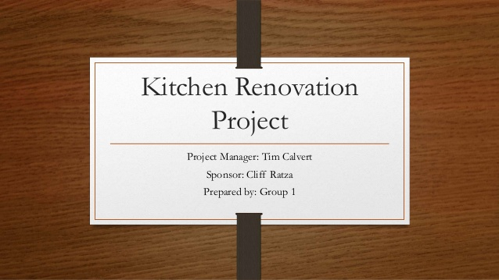

Project ?

Slide 6

Olympic : is it a project?

Slide 7
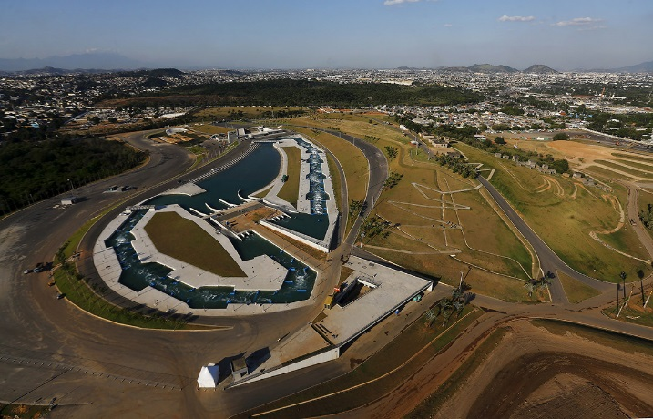
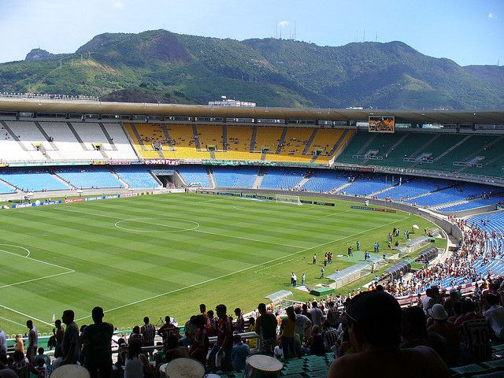
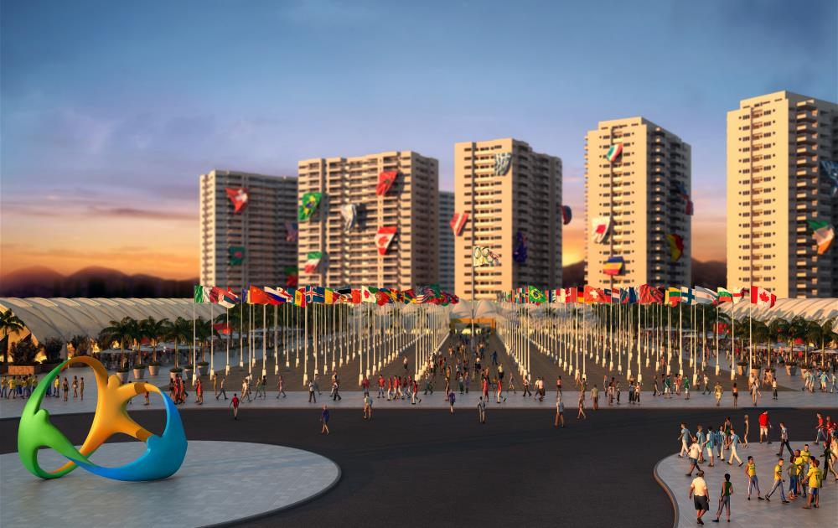
A Few Projects

Slide 8
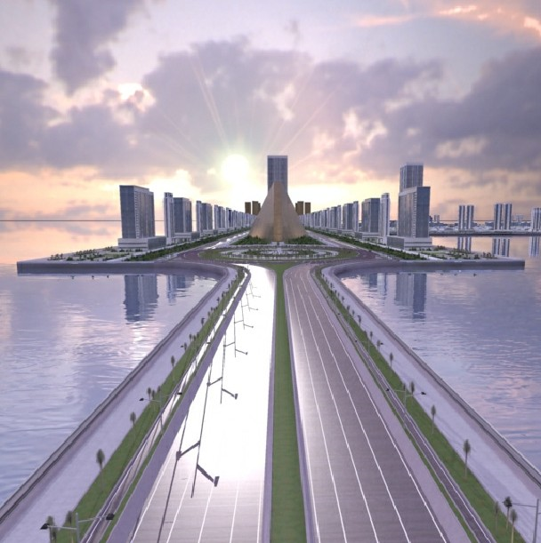
A few samples: ARTIFICIAL ISLAND – PANAMARINA PACIFIC

Slide 9

Fiat 500 EV : Electric motor powered
2013

Slide 10
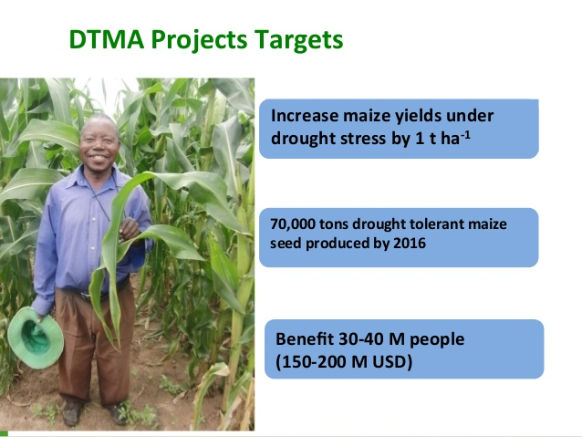
Drought Tolerant maize for Africa

Slide 11

Awareness Project

Slide 12

Sony Playstation 4 (PS4)
A table-style controller and state of the art graphics.

Slide 13
Comparison of Routine Work with Projects
Routine, Repetitive Work
Taking class notes
Daily entering sales receipts into the accounting ledger
Responding to a supply-chain request
Practicing scales on the piano
Routine manufacture of an Apple iPod
Attaching tags on a manufactured product
Projects
Writing a term paper
Setting up a sales kiosk for a professional accounting meeting
Developing a supply-chain information system
Writing a new piano piece
Designing an iPod that is approximately 2 X 4 inches, interfaces with PC, and stores 10,000 songs
Wire-tag projects for GE and Wal-Mart
TABLE 1.1
Notes:
Comparison of Routine Work with Projects
Projects should not be confused with everyday work. A project is not routine, repetitive work! Ordinary daily work typically requires doing the same or similar work over and over, while a project is done only once; a new product or service exists when the project is completed.
Routine, Repetitive Work
Taking class notes
Daily entering sales receipts into the accounting ledger
Responding to a supply-chain request
Practicing scales on the piano
Routine manufacture of an Apple iPod
Attaching tags on a manufactured product
Projects
Writing a term paper
Setting up a sales kiosk for a professional accounting meeting
Developing a supply-chain information system
Writing a new piano piece
Designing an iPod that is approximately 2 X 4 inches, interfaces with PC, and stores 10,000 songs
Wire-tag projects for GE and Wal-Mart

Slide 14
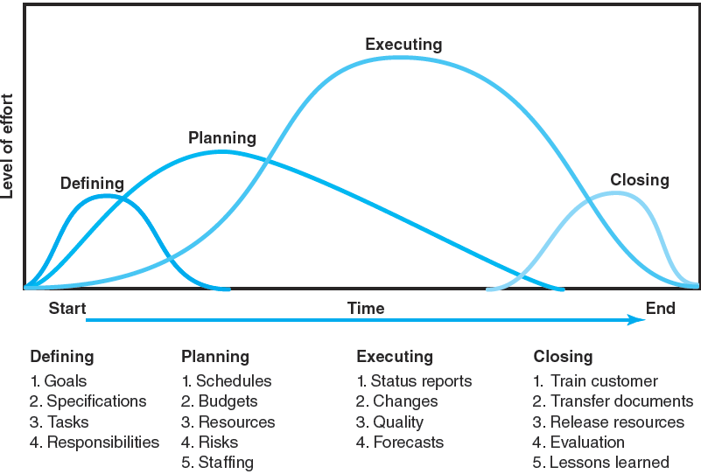
Project Life Cycle
FIGURE 1.1
Notes:
FIGURE 1.1 Project Life Cycle
Figure 1.1 illustrates the typical four sequential stages of a project’s life cycle in terms of its limited life span and the changes in level of effort and focus over time. The project life cycle passes through four stages: defining, planning, executing, and delivering. As depicted in the figure, project effort starts slowly, builds to a peak, and then declines to delivery of the project to the customer.
1. Defining stage: Specifications of the project are defined; project objectives are established; teams are formed; major responsibilities are assigned.
2. Planning stage: Plans are developed to determine what the project will entail, its schedule, whom it will benefit, the quality level to be maintained, and its initial budget.
3. Executing stage: The physical product is produced (a bridge, a report, a software program). Time, cost, and specification measures are used to control scheduling, budgeting, change specifications and forecasts
4. Closing stage: Delivering the project product to the customer may include customer training and transferring documents. Resources are redeployed to other projects and team members are reassigned. Post-project reviews include assessing performance and capturing lessons learned.

Slide 15
The Challenge of Project Management
The Project Manager
Manages temporary, non-repetitive activities and frequently acts independently of the formal organization.
Marshals resources for the project.
Is linked directly to the customer interface.
Provides direction, coordination, and integration to the project team.
Is responsible for performance and success of the project.
Must induce the right people at the right time to address the right issues and make the right decisions.
Notes:
The Challenge of Project Management
Project managers, unlike functional managers who take over existing operations, must first successfully build a project team of diverse individuals. After accomplishing that, they are responsible for making decisions, providing direction, coordination, and integration of the project team during the project’s life span.
The Project Manager
Manages temporary, non-repetitive activities and frequently acts independently of the formal organization.
Marshals resources for the project.
Is linked directly to the customer interface.
Provides direction, coordination, and integration to the project team.
Is responsible for performance and success of the project.
Must induce the right people at the right time to address the right issues and make the right decisions.

Slide 16
Current Drivers of Project Management
Factors leading to the increased use of project management:
Compression of the product life cycle
Knowledge explosion
Triple bottom line (planet, people, profit)
Corporate downsizing
Increased customer focus
Small projects represent big problems
Notes:
Current Drivers of Project Management
Several factors are contributing to the rapid increase in project management becoming a standard way of doing business. Project management is an increasingly important organizational skill as the role of projects grows in contributing to the strategic direction of organizations.
Factors leading to the increased use of project management:
Compression of the product life cycle
Knowledge explosion
Triple bottom line (planet, people, profit)
Corporate downsizing
Increased customer focus
Small projects represent big problems

Slide 17
Project Governance: An Integrative Approach
Integration (or centralization) of project management provides senior management with:
An overview of all project management activities
A big picture of how organizational resources are used
A risk assessment of their portfolio of projects
A rough metric of the firm’s improvement in managing projects relative to others in the industry
Linkages of senior management with actual project execution management
Notes:
Project Governance: An Integrative Approach
Centralization of project management processes and practices is essential to the success of firms competing in global markets influenced by rapid change, innovation, and the necessity to reduce time-to-market for products and services.
Integration (or centralization) of project management provides senior management with:
An overview of all project management activities
A big picture of how organizational resources are used
A risk assessment of their portfolio of projects
A rough metric of the firm’s improvement in managing projects relative to others in the industry
Linkages of senior management with actual project execution management

Slide 18
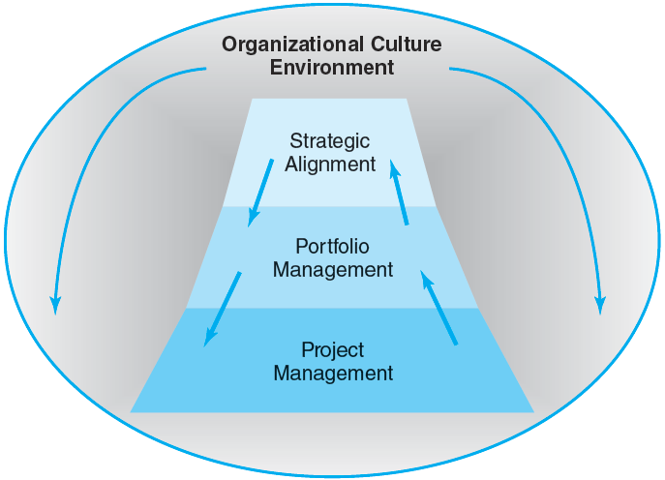
Integrated Management of Projects
FIGURE 1.2
Notes:
Figure 1.2 Integrated Management of Projects
Figure 1.2 shows how integrating all of the major dimensions of project management enables management to have greater flexibility and better control of all project management activities to move the organization toward its strategic goals. It necessitates combining all of the major dimensions of project management under one umbrella. Each dimension is connected to another in one seamless, integrated domain. Governance means applying a set of knowledge, skills, tools, and techniques to a collection of projects in order to move the organization toward its strategic goals. This integrative movement represents a major thrust of project driven organizations across all industries.

Slide 19
Alignment of Projects with Organizational Strategy
Problems resulting from the uncoordinated project management systems include:
Projects that do not support the organization’s overall strategic plan and goals.
Independent managerial decisions that create internal imbalances, conflicts and confusion resulting in dissatisfied customers.
Failure to prioritize projects results in the waste of resources on non-value-added activities/projects.
Notes:
Alignment of Projects with Organizational Strategy
Failure to strategically align the tangible and intangible resources of an organization results in efforts wasted on non-value-added activities/projects and increases an organization’s competitive risk.
Problems resulting from the uncoordinated project management systems include:
Projects that do not support the organization’s overall strategic plan and goals.
Independent managerial decisions that create internal imbalances, conflicts and confusion resulting in dissatisfied customers.
Failure to prioritize projects results in the waste of resources on non-value-added activities/projects.

Slide 20
Major Functions of Portfolio Management: The “Science” and “Art” of Project Management
Oversee project selection.
Monitor aggregate resource levels and skills.
Encourage use of best practices.
Balance projects in the portfolio in order to represent a risk level appropriate to the organization.
Improve communication among all stakeholders.
Create a total organization perspective that goes beyond silo thinking.
Improve overall management of projects over time.
Notes:
Major Functions of Portfolio Management: The “Science” and “Art” of Project Management
Successful project management is a continuous process that requires managers be instigators, implementers, communicators, organization structure developers, and strategic goals minders while they:
Oversee project selection.
Monitor aggregate resource levels and skills.
Encourage use of best practices.
Balance projects in the portfolio in order to represent a risk level appropriate to the organization.
Improve communication among all stakeholders.
Create a total organization perspective that goes beyond silo thinking.
Improve overall management of projects over time.

Slide 21
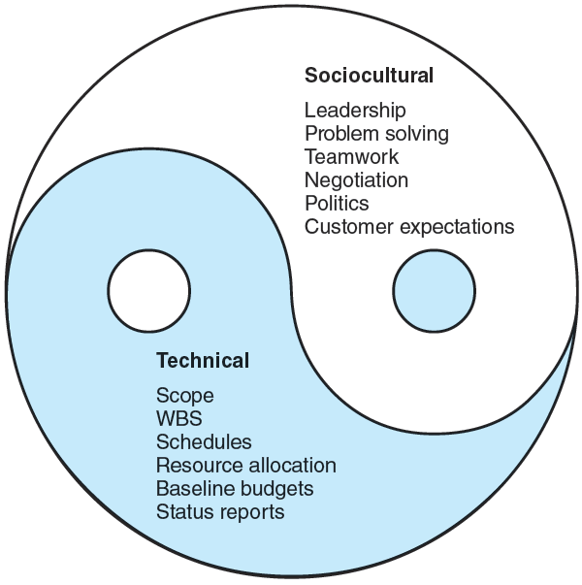

The Technical and Sociocultural Dimensions of the Project Management Process
FIGURE 1.3
Notes:
The Technical and Sociocultural Dimensions of the Project Management Process
Figure 1.3 (which closely resembles a “yin and yang” symbol) illustrates the necessity for project managers to have the skills sets required to successfully manage the two opposing dimensions of the project management process. They must administer the technical aspects of the management process while attending to the sociocultural side of project management.
The first dimension is the technical includes planning, scheduling, and controlling projects. Clear project scope statements are written to link the project and customer and to facilitate planning and control. Creation of the deliverables and work breakdown structures facilitates planning and monitoring the progress of the project. The work breakdown structure serves as a database that links all levels in the organization, major deliverables, and all work—right down to the tasks in a work package. Effects of project changes are documented and traceable. Thus, any change in one part of the project is traceable to the source by the integrated linkages of the system. This integrated information approach can provide all project managers and the customer with decision information appropriate to their level and needs. A successful project manager will be well trained in the technical side of managing projects.
The second and opposing dimension is the sociocultural side of project management which. involves creating a temporary social system within a larger organizational environment that combines the talents of a divergent set of professionals working to complete the project. The socio-cultural dimension also involves managing the interface between the project and external environment to build a cooperative social network among a divergent set of allies with different standards, commitments, and perspectives.

Slide 22
Key Terms
Program
Project
Project life cycle
Project Management Professional (PMP)
Notes:
Key project management terms with which students should be familiar after studying this chapter:
A program is a group of related projects designed to accomplish a common goal over an extended period of time.
A project is a temporary endeavor undertaken to create a unique product, service, or result.
A project life cycle is used to depict the sequential timing of the four major stages (defining,
planning, executing, and delivering tasks) that occur over the life of the project.
Project Management Professional (PMP) is someone who has documented sufficient project experience, has agreed to follow the Project Management Institute code of professional conduct, and has demonstrated mastery of the field of project management by passing a comprehensive examination.

